Slide 1
SQL Joins

Slide 2
RECAP (order of execution)
Select
Distinct A1,A2,….
From r1,r2,r3……
Where p
Group by (attribute set)
Having condition
Order by attribute set

Slide 3
RECAP
Select 5
Distinct A1,A2,…. 6
From r1,r2,r3…… 1
Where p 2
Group by (attribute set) 3
Having condition 4
Order by attribute set 7

Slide 4
SQL Joins
A join is a method of linking data between one or more tables based on values of the common column between the tables.
MySQL supports the following types of joins:
Self Join
Inner join
Left outer join
Right outer join
Full outer join
Cross join

Slide 5
SELF JOIN
A self JOIN is a regular join, but the table is joined with itself.
Self JOIN Syntax
SELECT column_name(s) FROM table1 T1, table1 T2 WHERE condition;

Slide 6
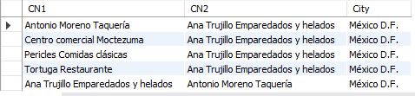
SELF JOIN
The following SQL statement matches customers that are from the same city:
select A.CustomerName as CN1, B.CustomerName as CN2, A.City
from Customers A, Customers B
where A.CustomerID <> B.CustomerID and
A.City = B.City limit 5;

Slide 7
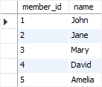

SAMPLE DATABASE
CREATE TABLE members (
member_id INT AUTO_INCREMENT,
name VARCHAR(100),
PRIMARY KEY (member_id) );
CREATE TABLE committees (
committee_id INT AUTO_INCREMENT,
name VARCHAR(100),
PRIMARY KEY (committee_id) );
INSERT INTO members(name) VALUES('John'),('Jane'),('Mary'),('David'),('Amelia’);
INSERT INTO committees(name) VALUES('John'),('Mary'),('Amelia'),('Joe');
Select * from members;
Select * from committee;

Slide 8

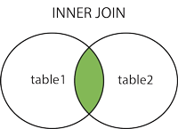
INNER JOIN
The INNER JOIN keyword selects records that have matching values in both tables.
INNER JOIN Syntax
SELECT column_name(s) FROM table1 INNER JOIN table2 ON table1.column_name = table2.column_name;

Slide 9

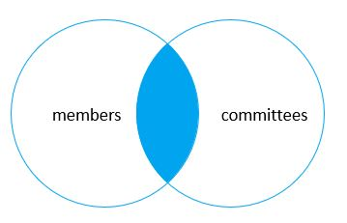
INNER JOIN
SELECT
m.member_id,
m.name members1,
c.committee_id,
c.name committee
FROM members m
INNER JOIN committees c ON
c.name = m.name;
1
SELECT
m.member_id,
m.name members1,
c.committee_id,
c.name committee
FROM members m
INNER JOIN committees c using (name);

Slide 10
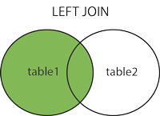
LEFT JOIN (or LEFT OUTER JOIN)
The LEFT JOIN keyword returns all records from the left table (table1), and the matched records from the right table (table2).
The result is NULL from the right side, if there is no match.
Left Join Syntax:
SELECT column_name(s) FROM table1 LEFT JOIN table2 ON table1.column_name = table2.column_name;
In some databases LEFT JOIN is called LEFT OUTER JOIN.

Slide 11
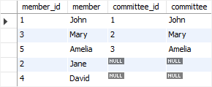
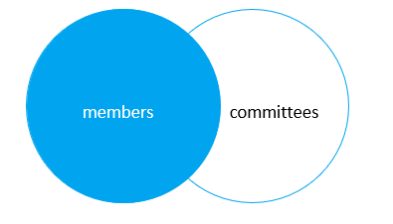
LEFT JOIN
SELECT
m.member_id,
m.name member1,
c.committee_id,
c.name committee
FROM members m
LEFT JOIN committees c USING(name);
1
SELECT
m.member_id,
m.name member1,
c.committee_id,
c.name committee
FROM members m
LEFT JOIN committees c ON
c.name = m.name;

Slide 12

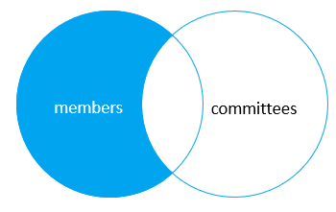
LEFT JOIN
SELECT
m.member_id,
m.name member,
c.committee_id,
c.name committee
FROM members m
LEFT JOIN committees c USING(name)
WHERE c.committee_id IS NULL;

Slide 13
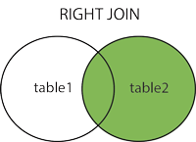
RIGHT JOIN (or RIGHT OUTER JOIN)
The RIGHT JOIN keyword returns all records from the right table (table2), and the matched records from the left table (table1). The result is NULL from the left side, when there is no match.
Syntax:
SELECT column_name(s) FROM table1 RIGHT JOIN table2 ON table1.column_name = table2.column_name;
It is also called RIGHT OUTER JOIN

Slide 14

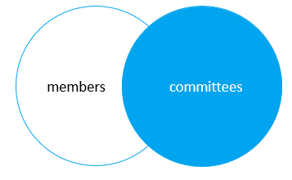
RIGHT JOIN
SELECT
m.member_id,
m.name member,
c.committee_id,
c.name committee
FROM members m
RIGHT JOIN committees c on
c.name = m.name;
SELECT
m.member_id,
m.name member,
c.committee_id,
c.name committee
FROM members m RIGHT JOIN
committees c USING(name);

Slide 15
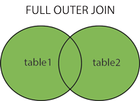
FULL OUTER JOIN
It returns all records when there is a match in left (table1) or right (table2) table records.
Note: FULL OUTER JOIN can potentially return very large result-sets!
Tip: FULL OUTER JOIN and FULL JOIN are the same.
Syntax
SELECT column_name(s) FROM table1 FULL OUTER JOIN table2 ON table1.column_name = table2.column_name WHERE condition;

Slide 16
CROSS JOIN
The cross join makes a Cartesian product of rows from the joined tables.
The cross join combines each row from the first table with every row from the right table to make the result set.
Suppose the first table has n rows and the second table has m rows.
The cross join that joins the first with the second table will return nxm rows.
Syntax:
SELECT select_list
FROM table_1
CROSS JOIN
table_2;

Slide 17
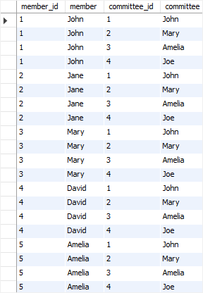
CROSS JOIN
SELECT
m.member_id,
m.name member,
c.committee_id,
c.name committee
FROM members m
CROSS JOIN committees c;

